Slide 1



Final Presentation
MGT 586- Data Visualization
Thuy Nguyen
Notes:
Hello, good day and welcome! My name is Thuy Nguyen and today I'm going to present you my final project for this Data Visualization class.

Slide 2

Introduction
New York City Airbnb Open Data from Kraggle. This dataset describes the listing activity and metrics in NYC, NY for 2019.
Learning purposes of choosing this dataset: Exploration/ Visualization/ Prediction
Notes:
First of all, I’d like to introduce you to my dataset that I’ve chosen for this project. It is about the NYC Airbnb business open data from Kraggle that was collected from 48,896 rentals around the main 5 boroughs in NYC. This dataset describes the listing activities and metrics for the year of 2019 such as host id, listing id, rental type, reviews, locations, room rate and availability.
Secondly, I'd like to talk about the learning purposes from researching this dataset. I hope that I'll bring out some helpful business insights and predictions from my data visualization skills as I'm taking you to explore this dataset with me.

Slide 3
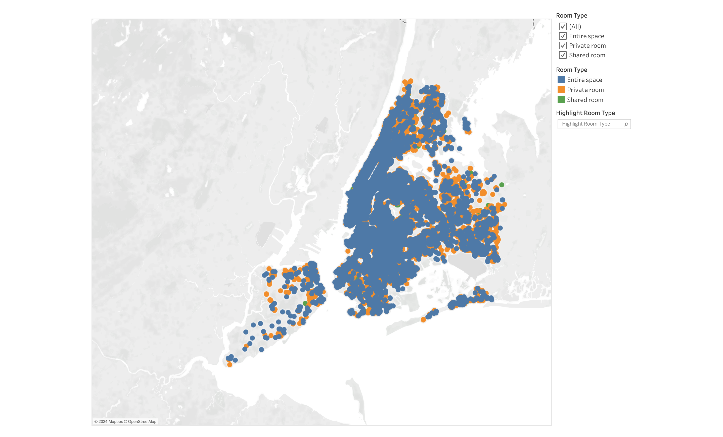

Which kind of Airbnb rental is most popular in NYC area?
Notes:
The 1st question I have is that "...". In this question, I've applied longitude and latitude to map each rental. From using Room type as a legend, we can clearly see that "Entire Space" which is in blue, is the most popular rental type in NYC.

Slide 4
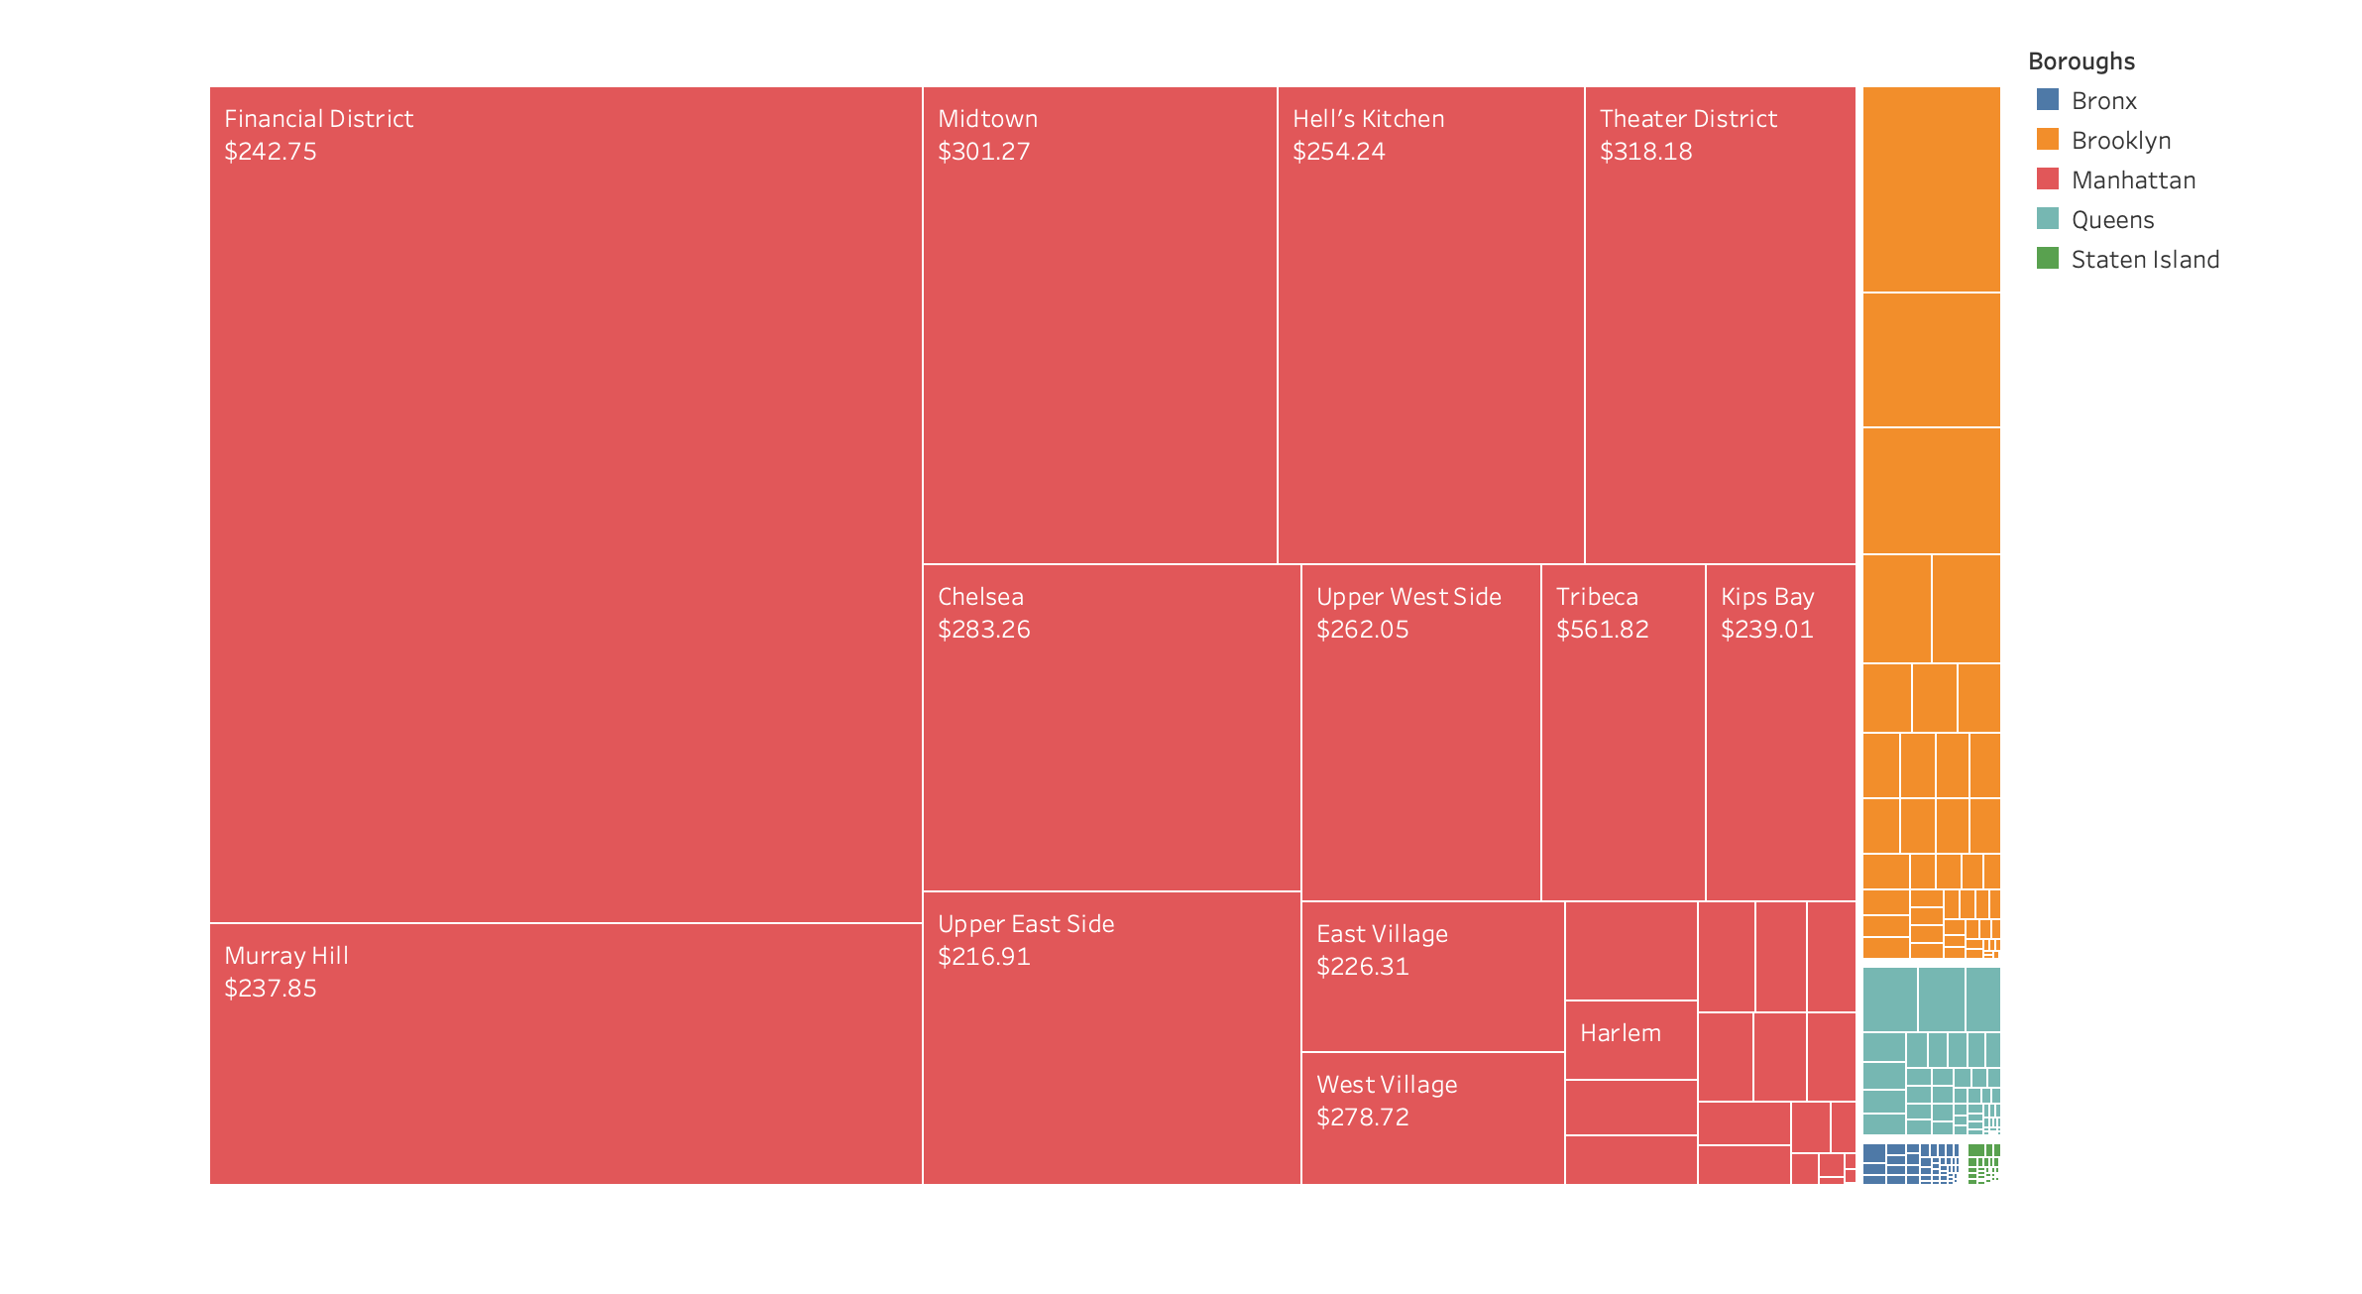
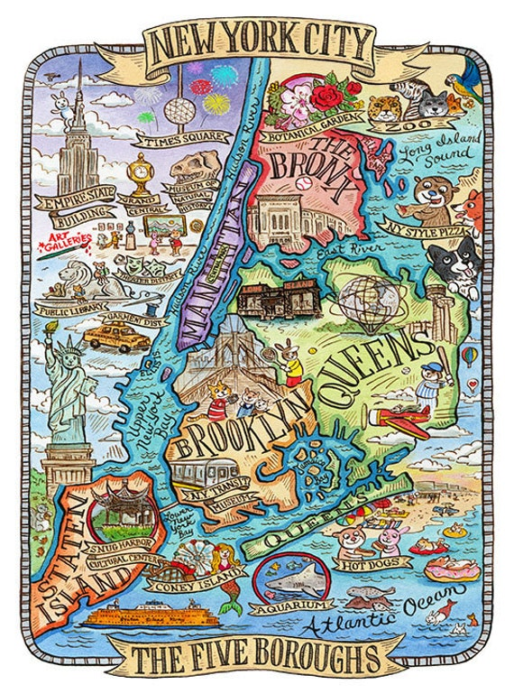
Which borough has the highest number of entire space listings and what is their neighborhoods' average room rate?
Notes:
To follow up with the popularity of entire space rentals in NYC, my 2nd question is "...". In this question, I've used square map and used "size" as marks for the Sum of Listings. I've also grouped "Boroughs" and used it as a Legend. It shows that majority of entire space listings is from Manhattan. In addition, the average room rate for entire space in Manhattan is not very cheap, it was somewhere between $200-$300, not even mention it could go up to $561 in Tribecca.

Slide 5
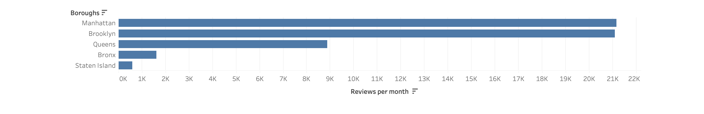
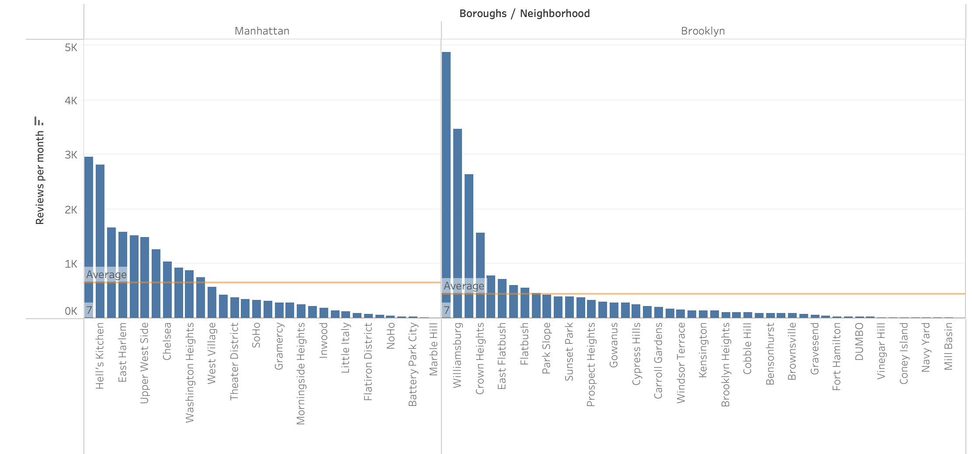
How many reviews per month does each borough have? Quick comparison on top reviewed boroughs in NYC.
Notes:
For the next slide, I'm going to talk about how many reviews per month does each borough have and then run a quick comparison on the top 2 reviewed boroughs.
We can see that based on the first quantitative chart, Manhattan and Brooklyn were the most reviewed boroughs on Airbnb (with more than 21k reviews per month), followed by Queens with slightly under 9k reviews. The least reviewed boroughs could be mentioned with Bronx (under 2k) and Staten Island (only under 1k reviews per month).
Onto the next one, I've picked Manhattan and Brooklyn and created a set called "Top 2 reviewed boroughs around NYC" to show you some fun comparisons. Looking at the chart at the bottom, we can see even though there're some neighborhoods in Brooklyn has more reviews per months than Hell's Kitchen in Manhattan, the average reviews per month in Manhattan was not a lot, but still slightly higher than Brooklyn. In my opinion, one of the reasons could be because there're more small neighborhoods in Brooklyn than in Manhattan.

Slide 6
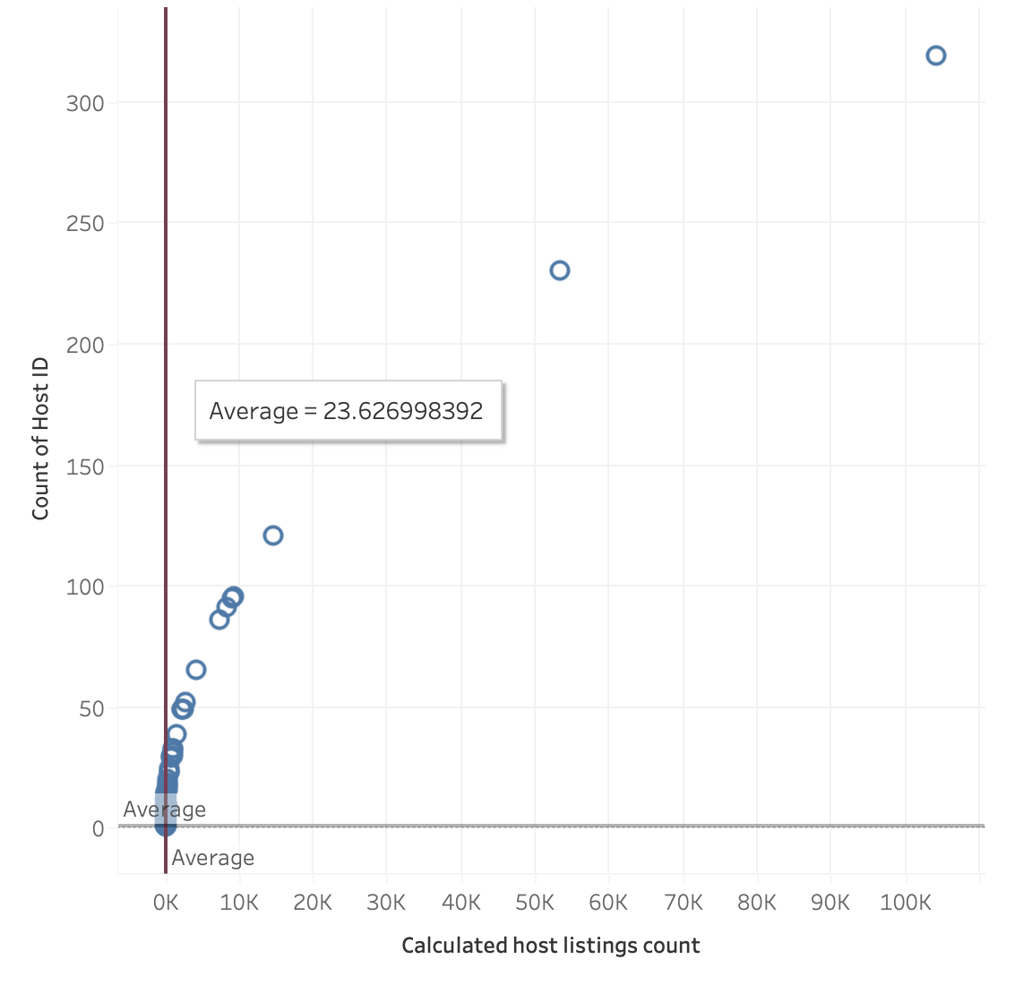
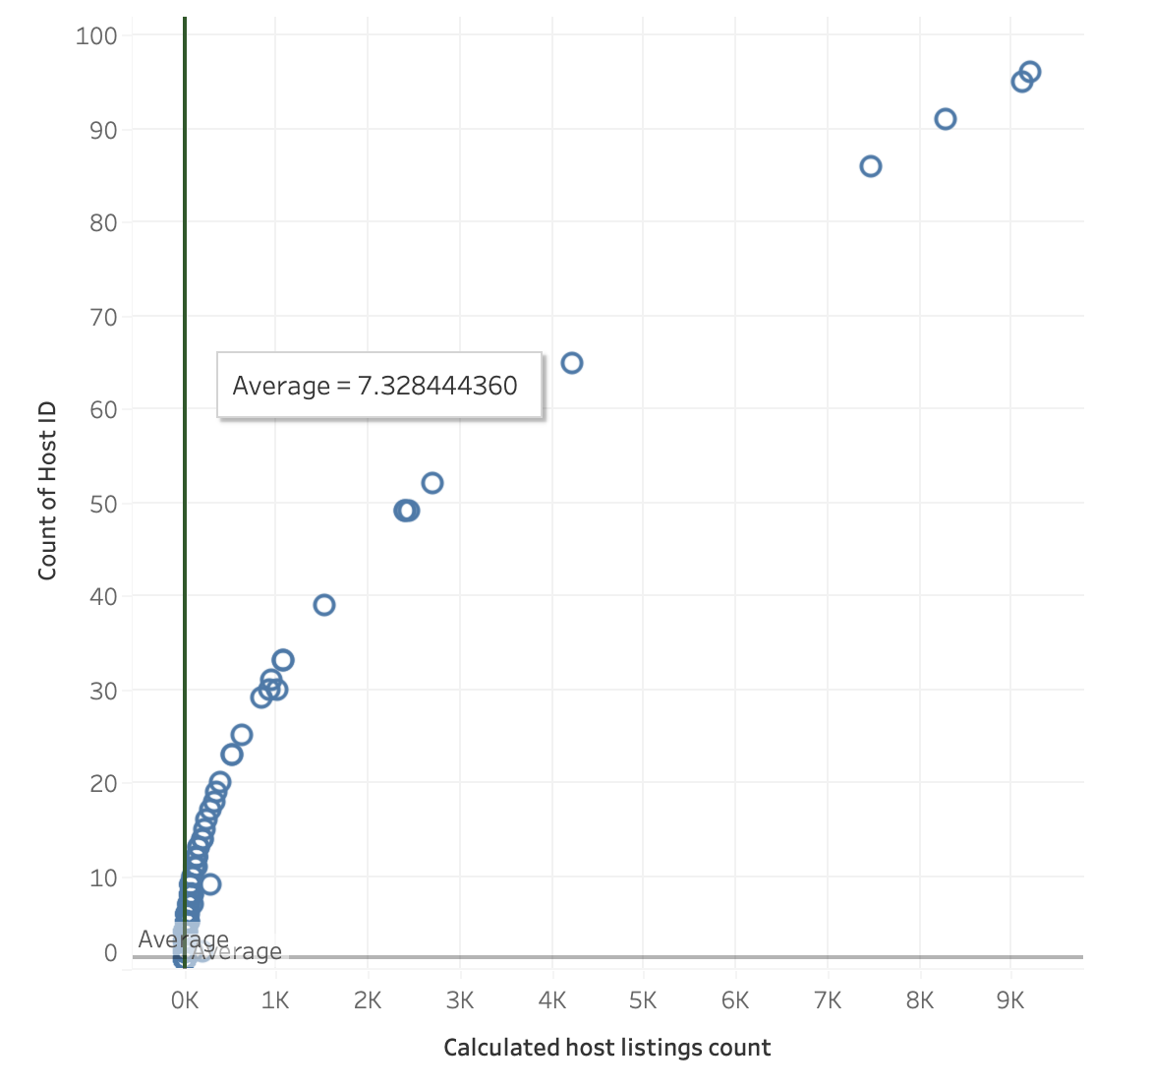
How many listings are there do Airbnb hosts in Manhattan (with entire space) have?
Notes:
Back to the popularity of Entire space rentals in NYC, my next business question is: "How many listings are there do Airbnb hosts in Manhattan with entire space have?"
The first scatter plot is showing all hosts with entire space in Manhattan and as we can see, the average listings per host with entire space rental in Manhattan 23 rentals. However, there're a few huge numbers ( 1 is 50k and 1 is 100k) that seem not to be in the same range as the rest.
That encouraged me to weed out the big numbers in order to make it more accurate for comparisons. So I've made a second scatter plot that ranges from 1 to 10,000 rentals only. That spreads out well and shows us a more stable density of rental ownerships. As a result, most hosts who own entire space in Manhattan mainly own under 2,000 rentals.

Slide 7
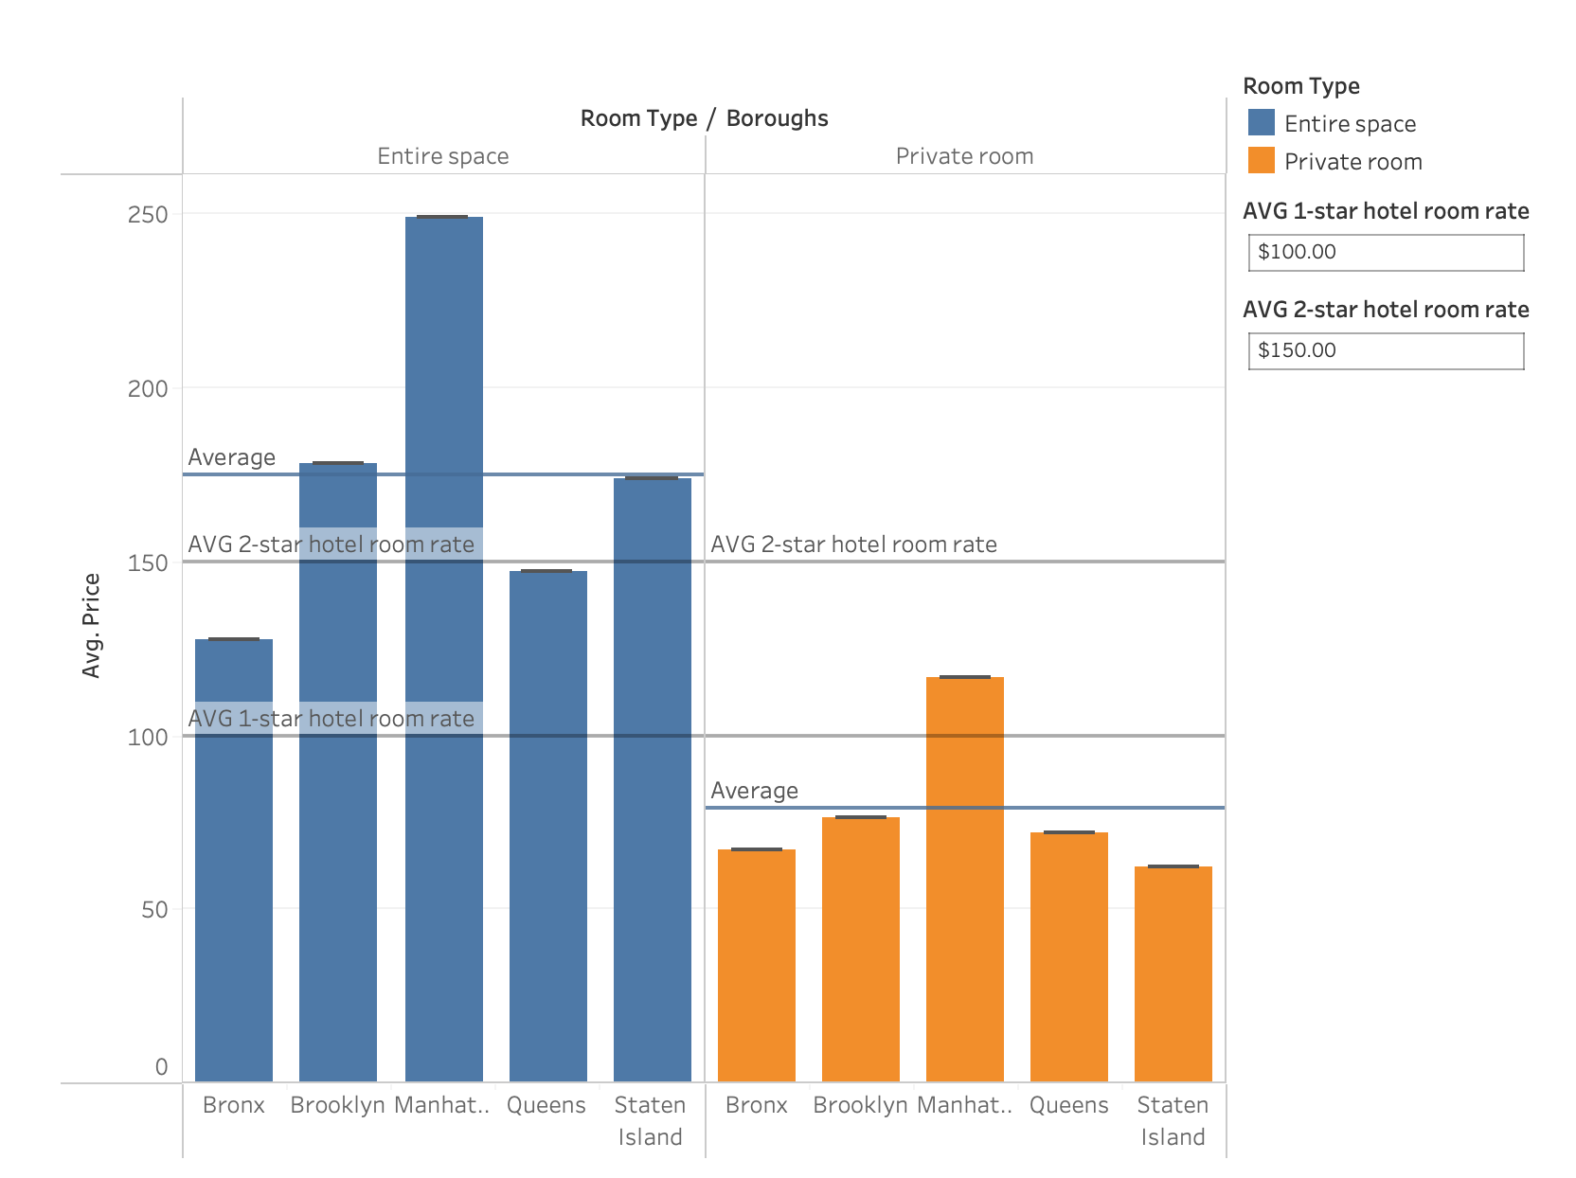
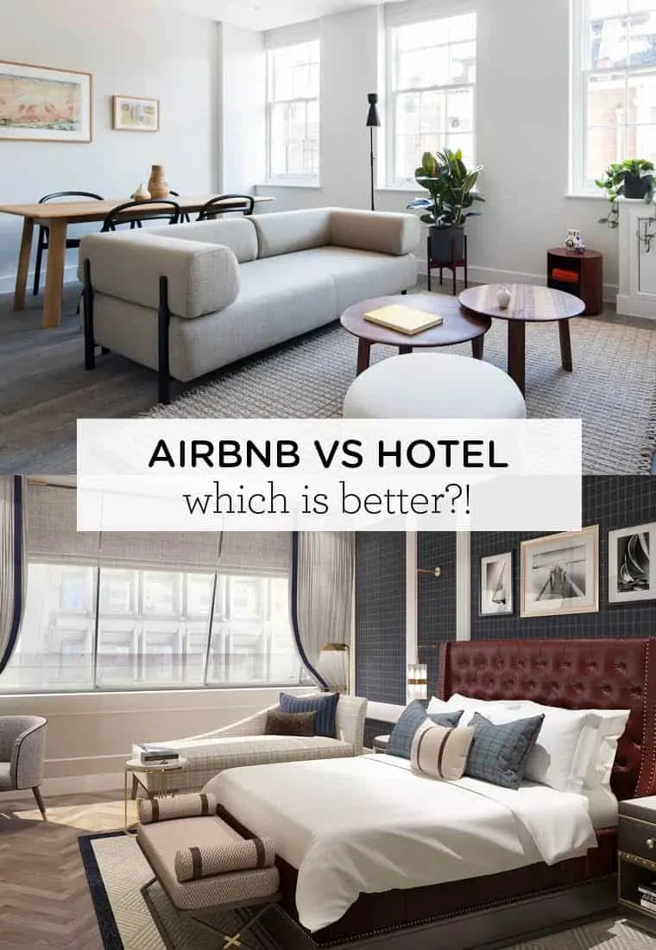
Comparisons in price between Airbnb rentals, 1-star hotel and 2-star hotel.
Notes:
Lastly, let's do a comparison in room rate between Airbnb rentals, average 1-star and 2-star hotel in NYC.
I've filtered only Entire Space and Private Room as they're similar with regular hotel room. I've also calculated the average Airbnb rental rate, added 1-star hotel rate and 2-star hotel rate to $100 and $150 as reference lines according to NYC hotel average room rate in 2019.
By looking at the chart, it's suggested that average room rate for private room in general is most affordable, followed with 1-star hotel, 2-star hotel. Average room rate for entire space is the most expensive, especially in Manhattan.
To conclude, it seems to make more sense to stay in a private room or 1-star hotel if people traveled on a budget.
On another hand, staying in a 2-star hotel room will give better money value such as amenities and check-in services given paying the same price for entire space in expensive areas like Manhattan, Brooklyn or Staten Island.

Slide 8
Conclusions
Location Insights
Rental Ownerships
Price Sensitivity
Recommendation
Notes:
Last but not least, I'd love to finalize some thoughts on this project.
Location: Understand patterns in popularity across different neighborhoods or cities. Identify areas with high demand and consider expanding or adjusting listings accordingly.
Rental ownerships: Understand rental ownerships and the amounts of properties they contract with Airbnb helps to learn and understand the market.
Price Sensitivity: Insights into price elasticity can inform pricing strategies to maximize profitability while remaining competitive.
Recommendation for improvements: Adjustments to pricing strategies, investment in specific amenities, or targeted marketing campaigns.

Slide 9

Thank you for listening!

